Slide 1
State of the Teacher Workforce
Analysis of Publicly Available Teacher Data Across Houston School Systems 2012-2022

Slide 2
Teachers and Staff
District | # Campuses | # Students | # Teachers | Teachers per Campus (Average)
Aldine ISD | 78 | 61,528 | 3,942 | 50.5
Alief ISD | 45 | 40,642 | 3,172 | 70.5
Channelview ISD | 13 | 9,503 | 602 | 46.3
Galena Park ISD | 25 | 21,400 | 1,397 | 55.9
Houston ISD | 273 | 193,727 | 10,620 | 38.9
Pasadena ISD | 67 | 49,255 | 3,828 | 57.1
Sheldon ISD | 13 | 10,565 | 629 | 48.4
Spring ISD | 42 | 33,406 | 2,177 | 51.8
Spring Branch ISD | 46 | 33,474 | 2,197 | 47.8
YES Prep | 19 | 14,557 | 858 | 45.2
Source: TEA TAPR, 2022

Slide 3
Teachers and Other Staff by District
District | # Teachers | # Librarians | # Counselors | # Campus Leaders | # Central Admin | # Educational Aides
Aldine ISD | 3,942 | 0 | 180 | 282 | 105 | 952
Alief ISD | 3,172 | 41 | 156 | 169 | 83 | 719
Channelview ISD | 602 | 3 | 25 | 36 | 15 | 153
Galena Park ISD | 1,397 | 21 | 49 | 89 | 57 | 253
Houston ISD | 10,620 | 56 | 262 | 530 | 152 | 1,188
Pasadena ISD | 3,828 | 70 | 130 | 196 | 88 | 1,071
Sheldon ISD | 629 | 10 | 21 | 36 | 16 | 167
Spring ISD | 2,177 | 40 | 93 | 128 | 33 | 474
Spring Branch ISD | 2,197 | 38 | 75 | 126 | 47 | 424
YES Prep | 858 | 0 | 30 | 96 | 72 | 3
Source: TEA TAPR, 2022

Slide 4
Teacher Demographics

Slide 5
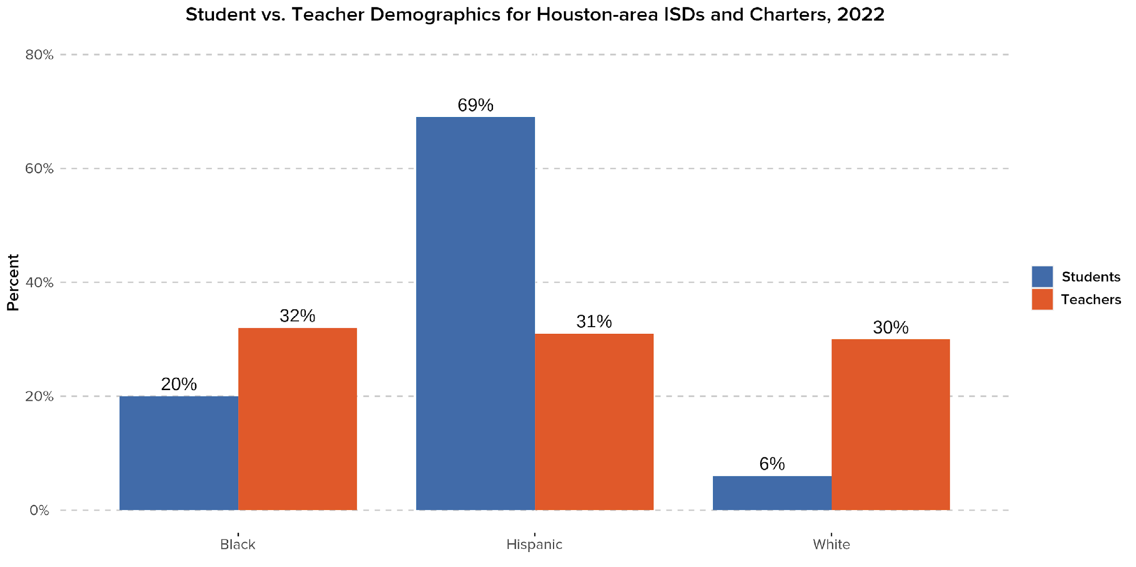
Houston-area ISDs and charters show large gaps between their student and teacher demographics for key groups.
-38pp
+12pp
+24pp
Source: TEA TAPR, 2022

Slide 6
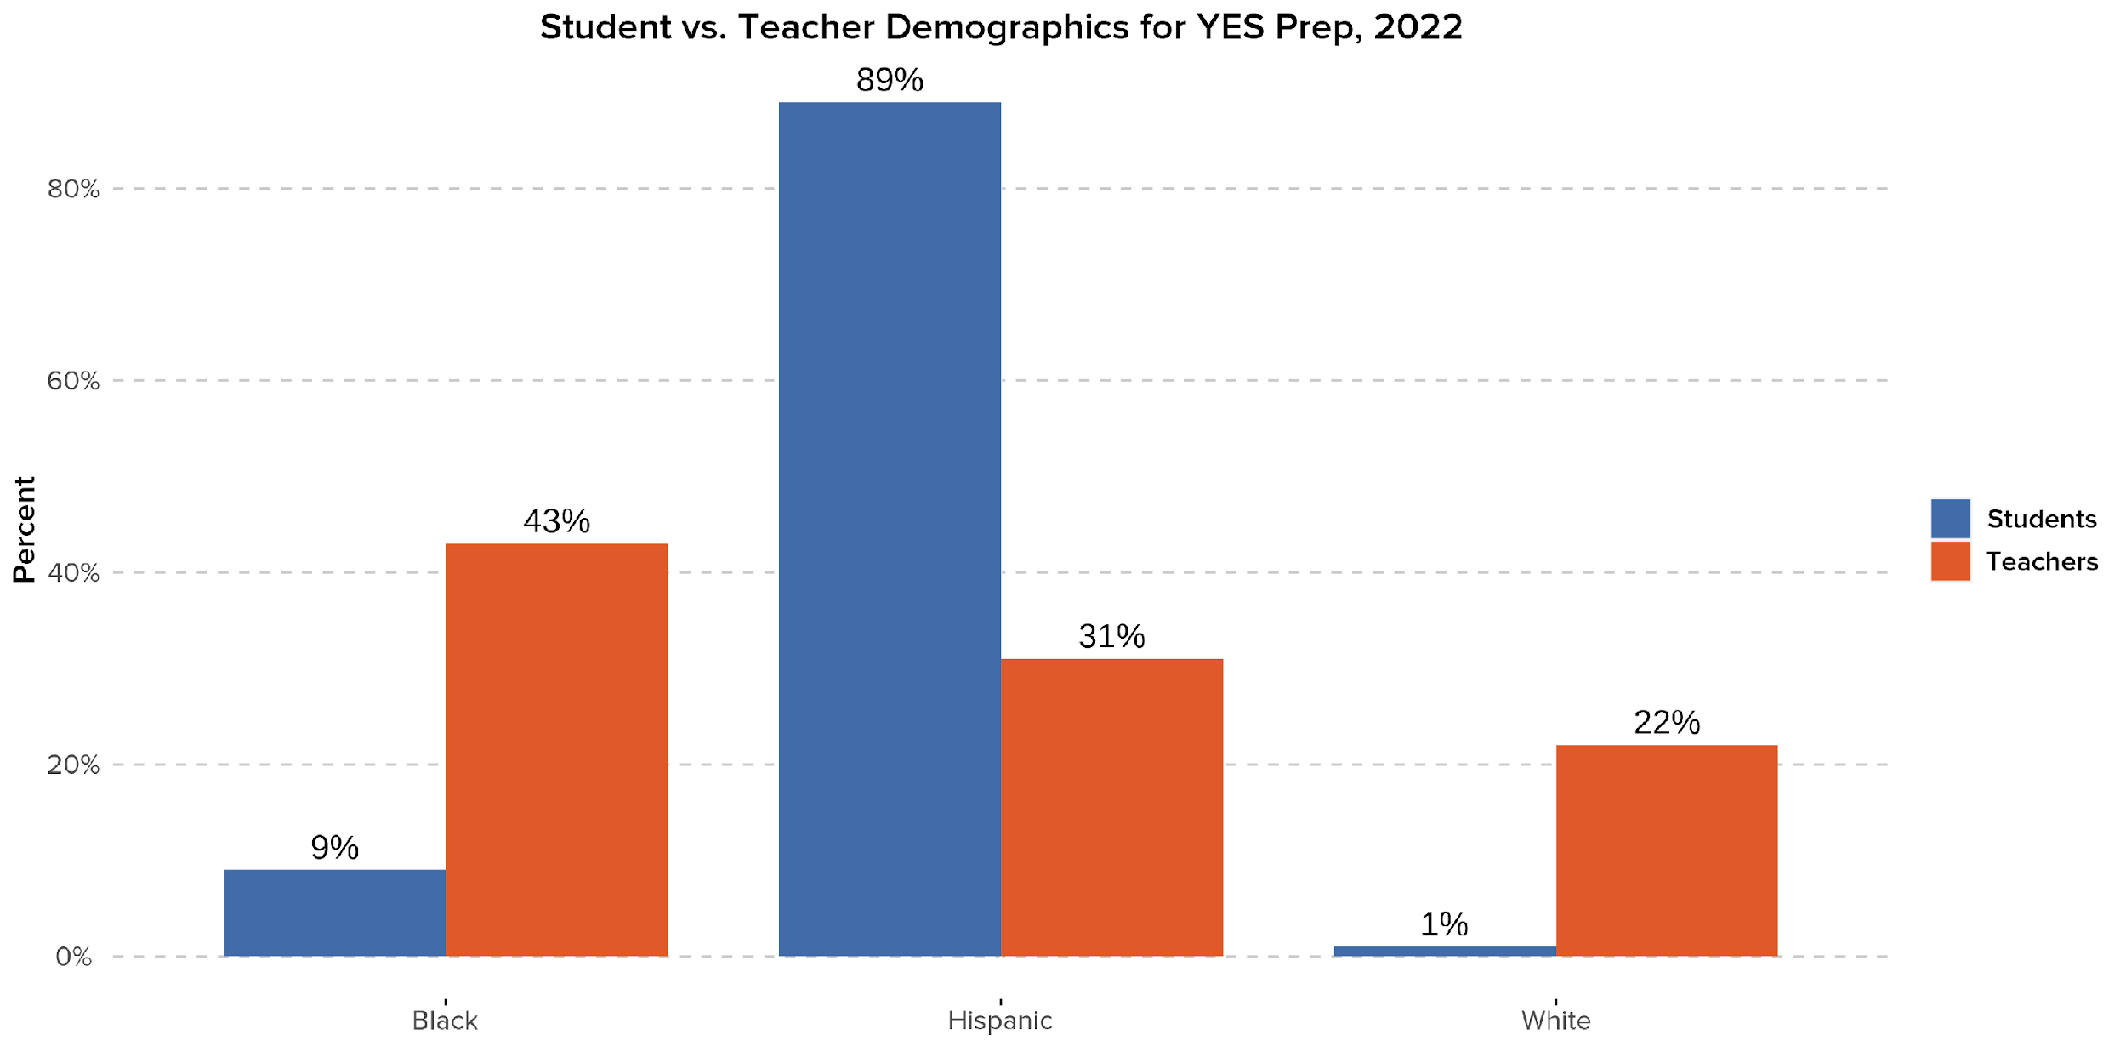
At YES Prep schools, Hispanic teachers are even more underrepresented compared to Hispanic students.
The proportion of YES Prep students who identify as Hispanic is nearly 3x that of teachers who identify as Hispanic.
-58pp
+34pp
+21pp
Source: TEA TAPR, 2022

Slide 7
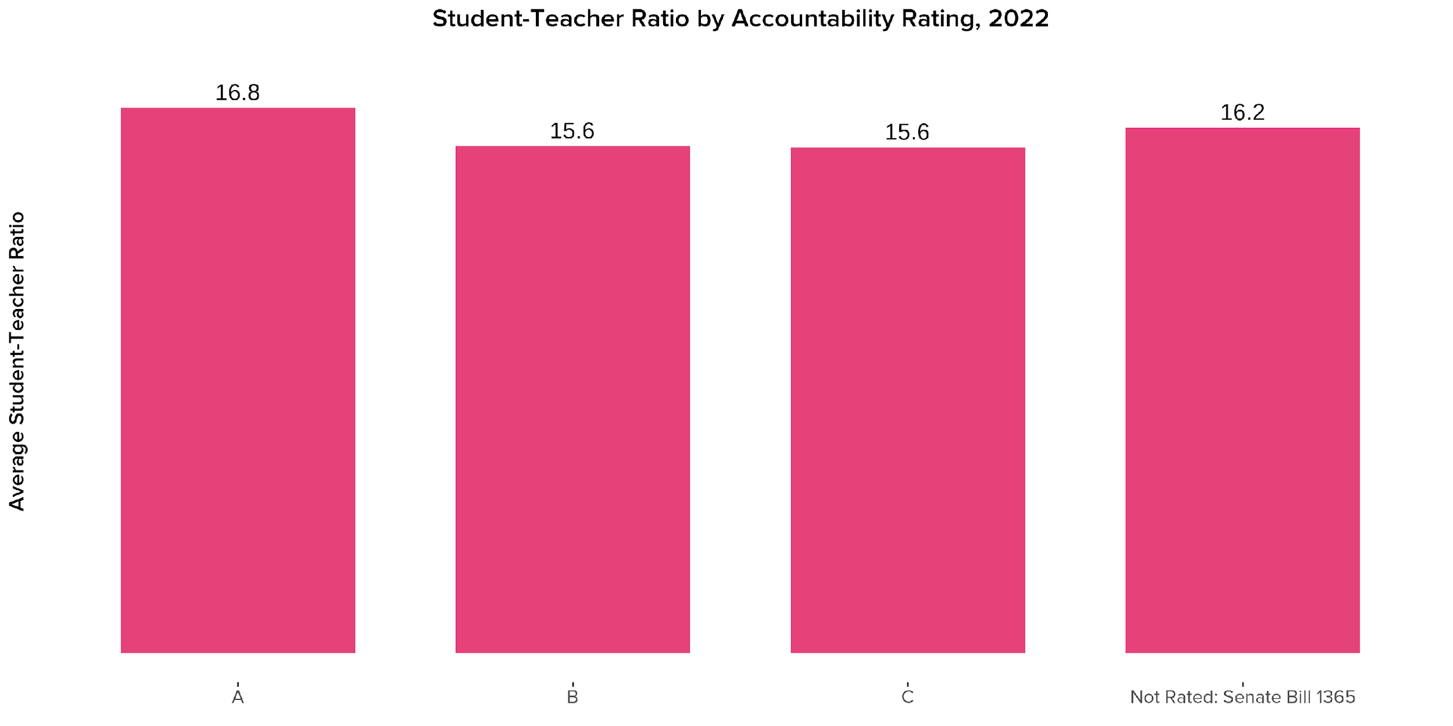
On average, A-rated campuses have higher student-teacher ratios than campuses with lower accountability ratings.
Source: TEA TAPR, 2022

Slide 8
Teacher Retention & Experience

Slide 9
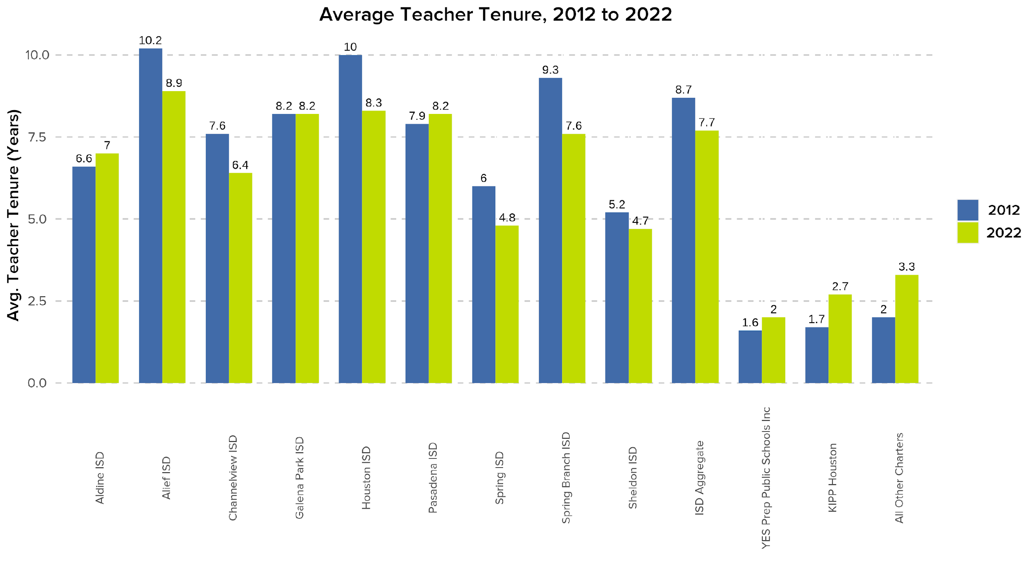
Most Houston-area ISDs saw decreases in average teacher tenure since 2012, showing teachers are staying with a district for less time.
Source: TEA TAPR, 2012 and 2022

Slide 10
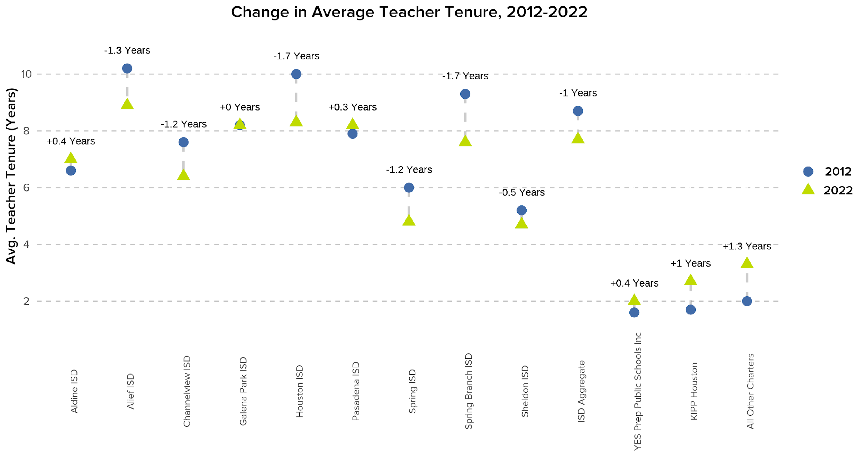
6 Houston-area ISDs saw their average teacher tenure decline by a year or more from 2012 to 2022.
Source: TEA TAPR, 2012 and 2022

Slide 11
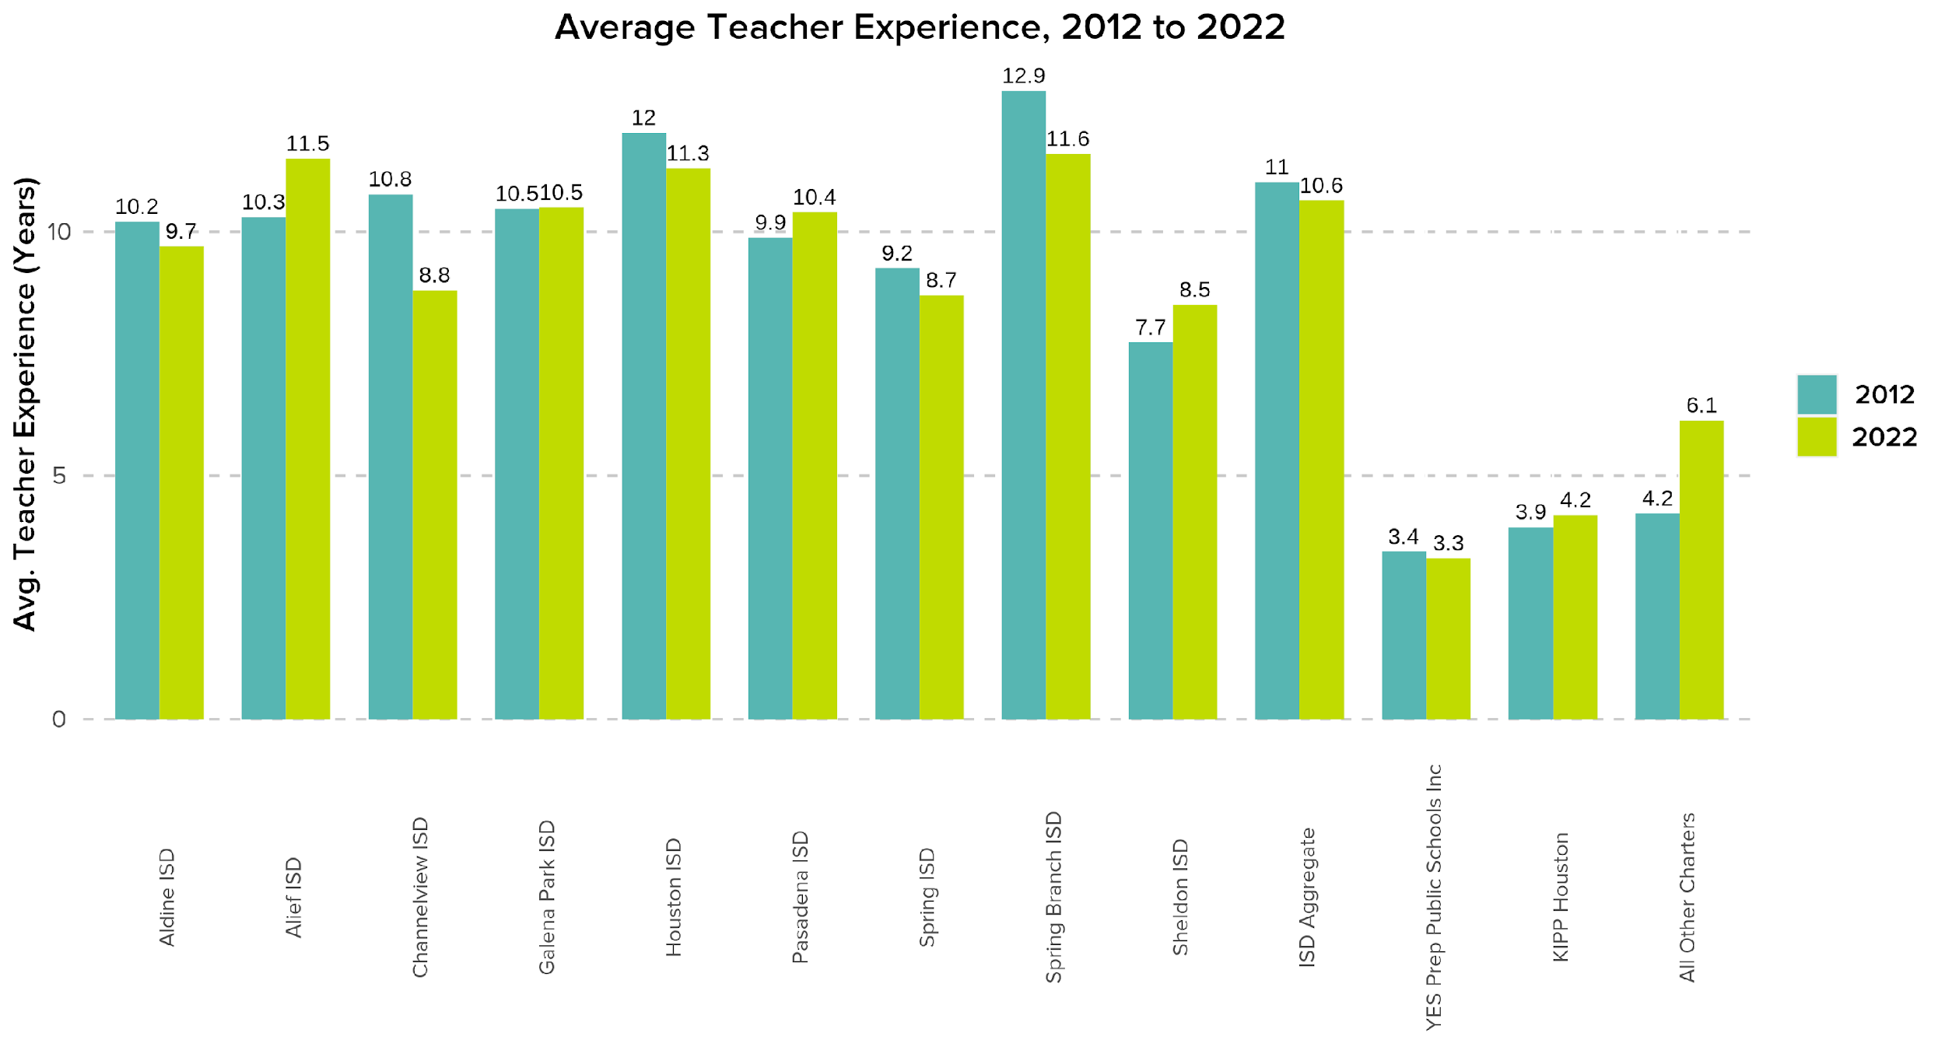
Similarly, average teacher experience has declined or stayed flat since 2012 at many—but not all—Houston-area ISDs.
Source: TEA TAPR, 2012 and 2022

Slide 12
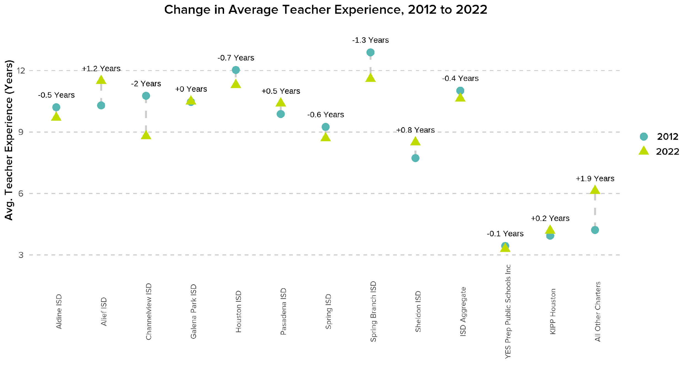
Three Houston-area ISDs saw their average teacher experience increase from 2012 to 2022.
Alief, Pasadena, and Sheldon ISDs saw increases in average teacher experience since 2012
Source: TEA TAPR, 2012 and 2022

Slide 13
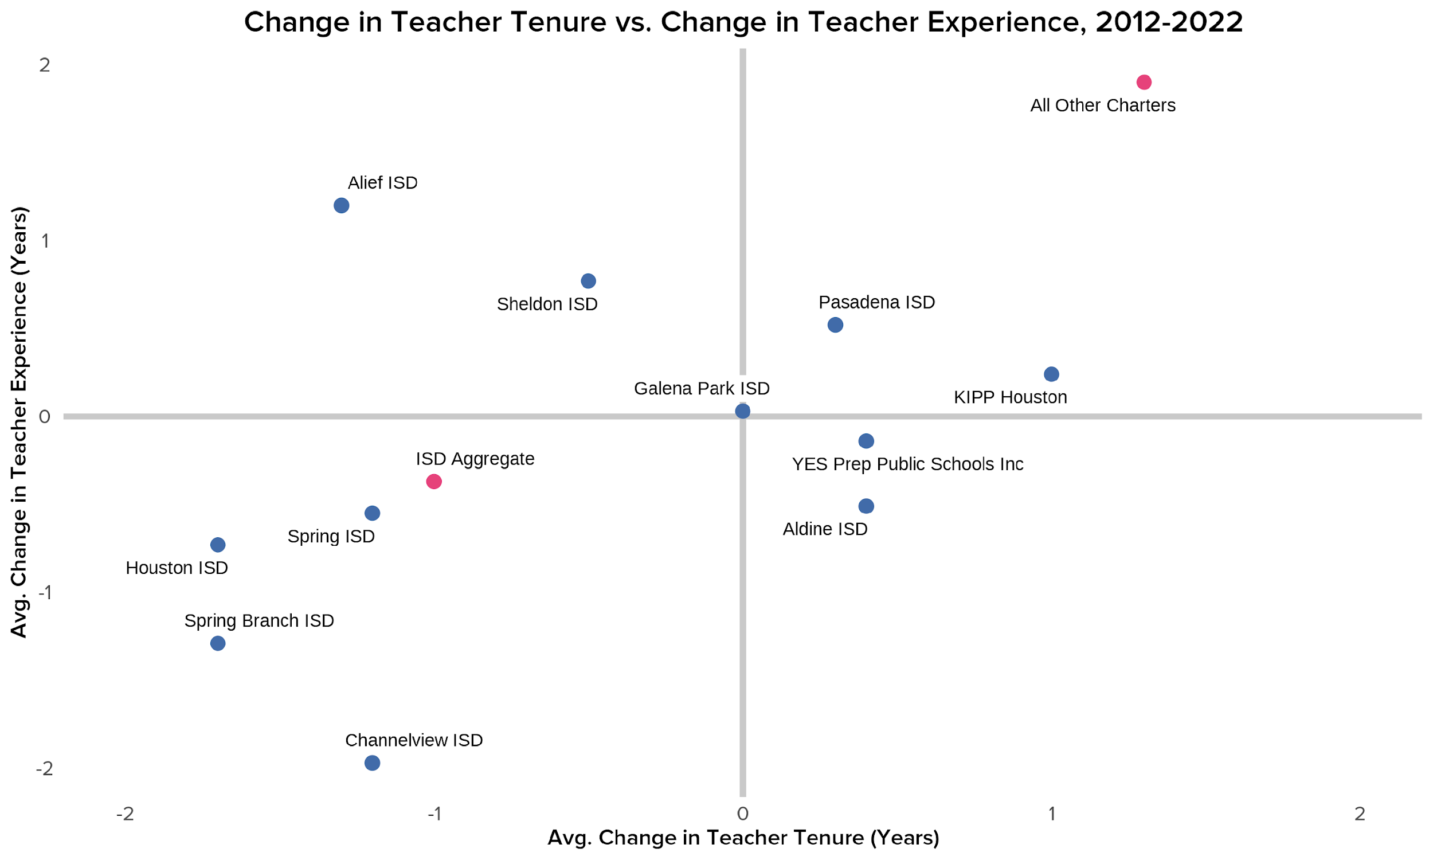
Only Pasadena ISD, KIPP, and other charters saw increases in both average teacher experience and teacher tenure since 2012.
These districts all saw their teachers stay within the district longer, on average, and saw their average teacher experience grow.
Source: TEA TAPR, 2012 and 2022

Slide 14
Four Houston-area ISDs saw decreases in both average teacher tenure and experience since 2012.
Conversely, these districts all saw their teachers stay within the district for less time, on average, and saw their average teacher experience decline.
Source: TEA TAPR, 2012 and 2022

Slide 15
Teacher Turnover

Slide 16
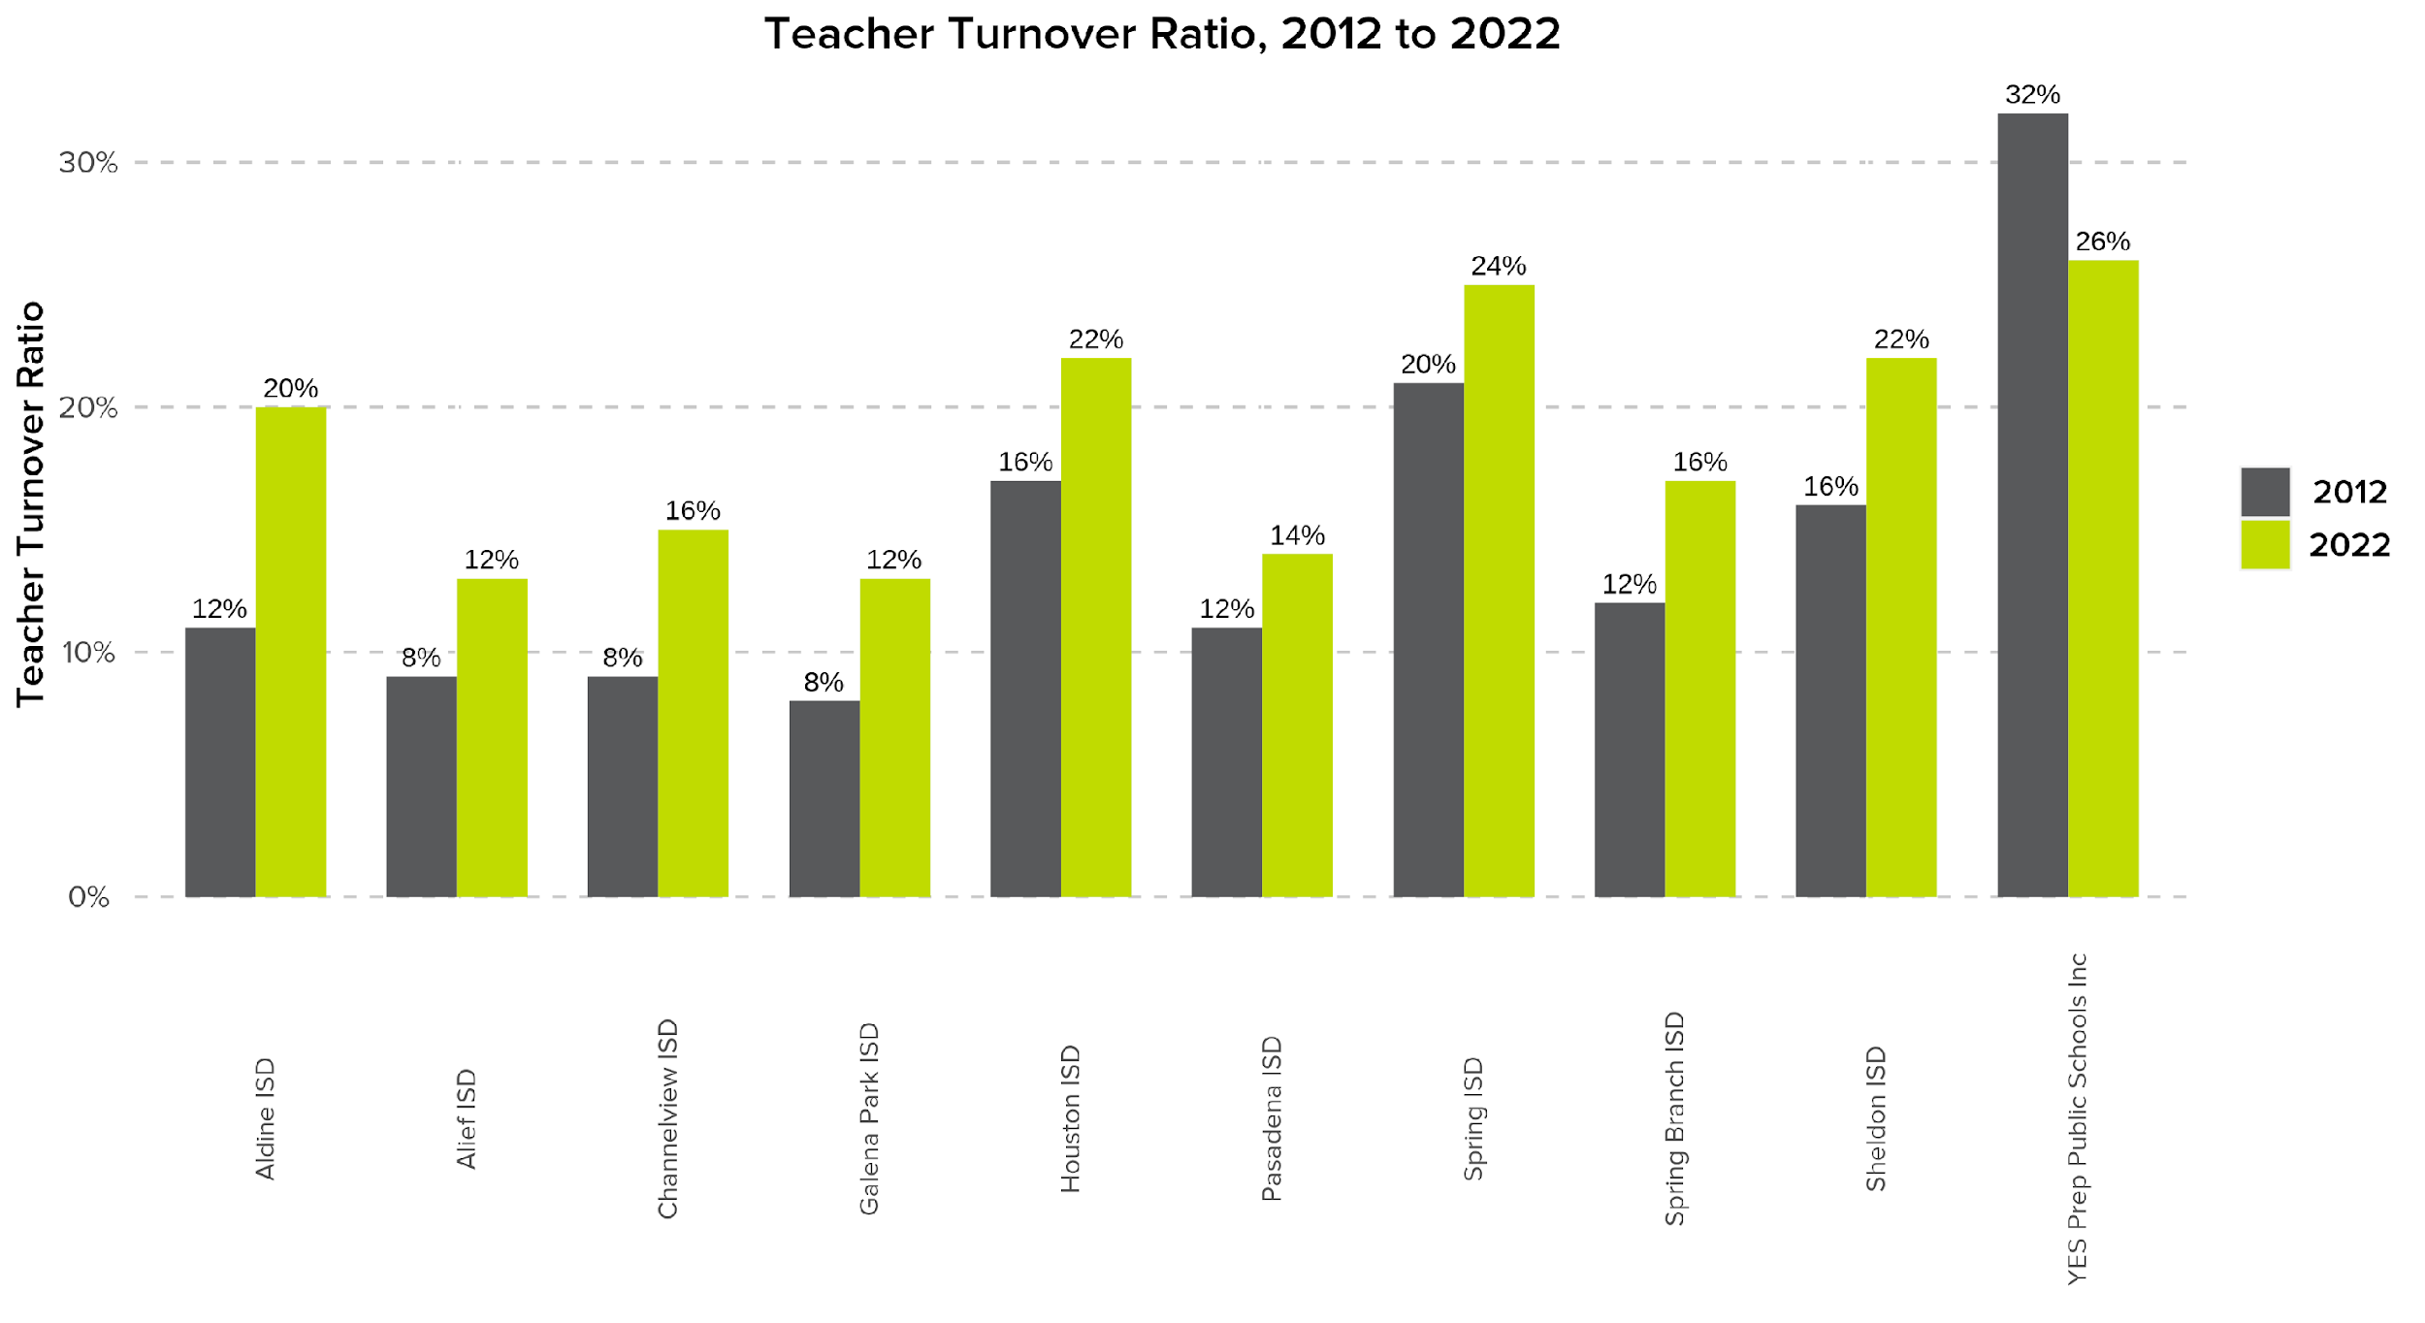
All Houston-area ISDs saw increases in their teacher turnover ratios since 2012, while YES Prep’s teacher turnover declined.
Source: TEA TAPR, 2012 and 2022

Slide 17
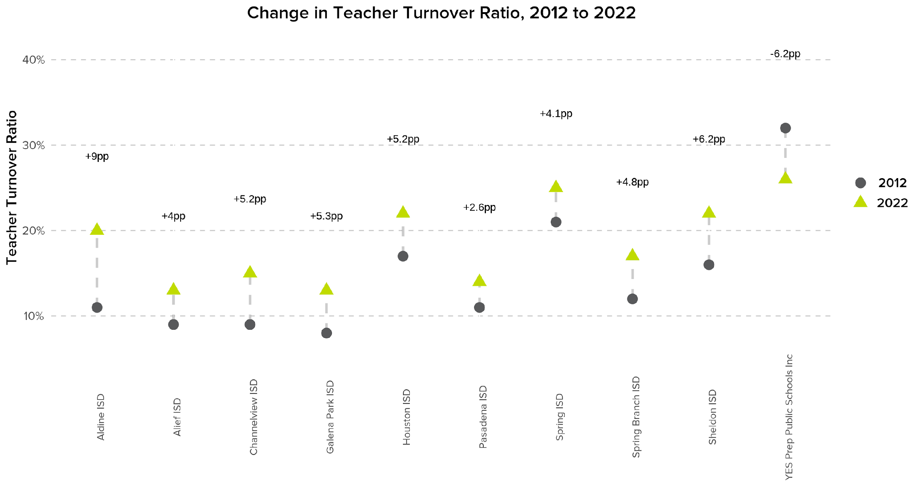
Most Houston-area ISDs saw their teacher turnover ratios increase by 4+ percentage points since 2012.
Source: TEA TAPR, 2012 and 2022

Slide 18
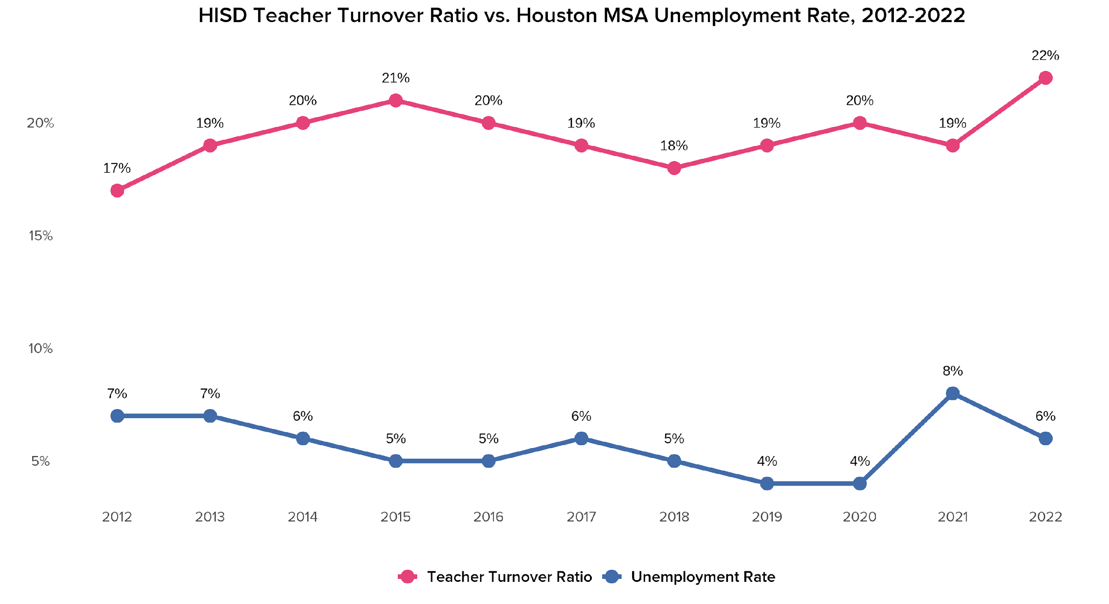
Teacher turnover in Houston ISD is inversely related to the Houston region’s unemployment rate.
During periods of high unemployment, teachers are more likely to stay in the profession.
Source: TEA TAPR, 2012-2022; U.S. Bureau of Labor Statistics, Unemployment Rate in Houston-The Woodlands-Sugar Land, TX (MSA), 2012-2022. Unemployment rates represent unemployment rate as of January of the listed year.

Slide 19
Teacher turnover in Houston ISD is inversely related to the Houston region’s unemployment rate.
With better labor market conditions, though, teachers are more likely to leave the profession.
Source: TEA TAPR, 2012-2022; U.S. Bureau of Labor Statistics, Unemployment Rate in Houston-The Woodlands-Sugar Land, TX (MSA), 2012-2022. Unemployment rates represent unemployment rate as of January of the listed year.

Slide 20
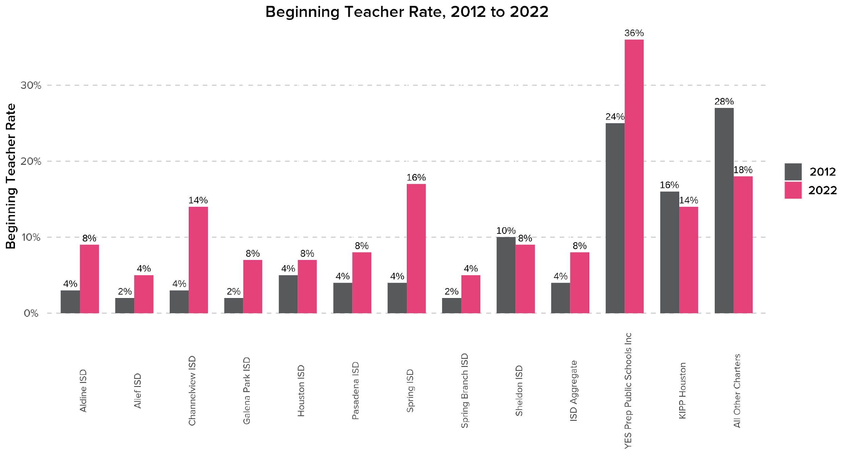
As teacher turnover ratios have increased, so has the proportion of beginning teachers at most Houston-area ISDs and charters.
Source: TEA TAPR, 2012 and 2022

Slide 21
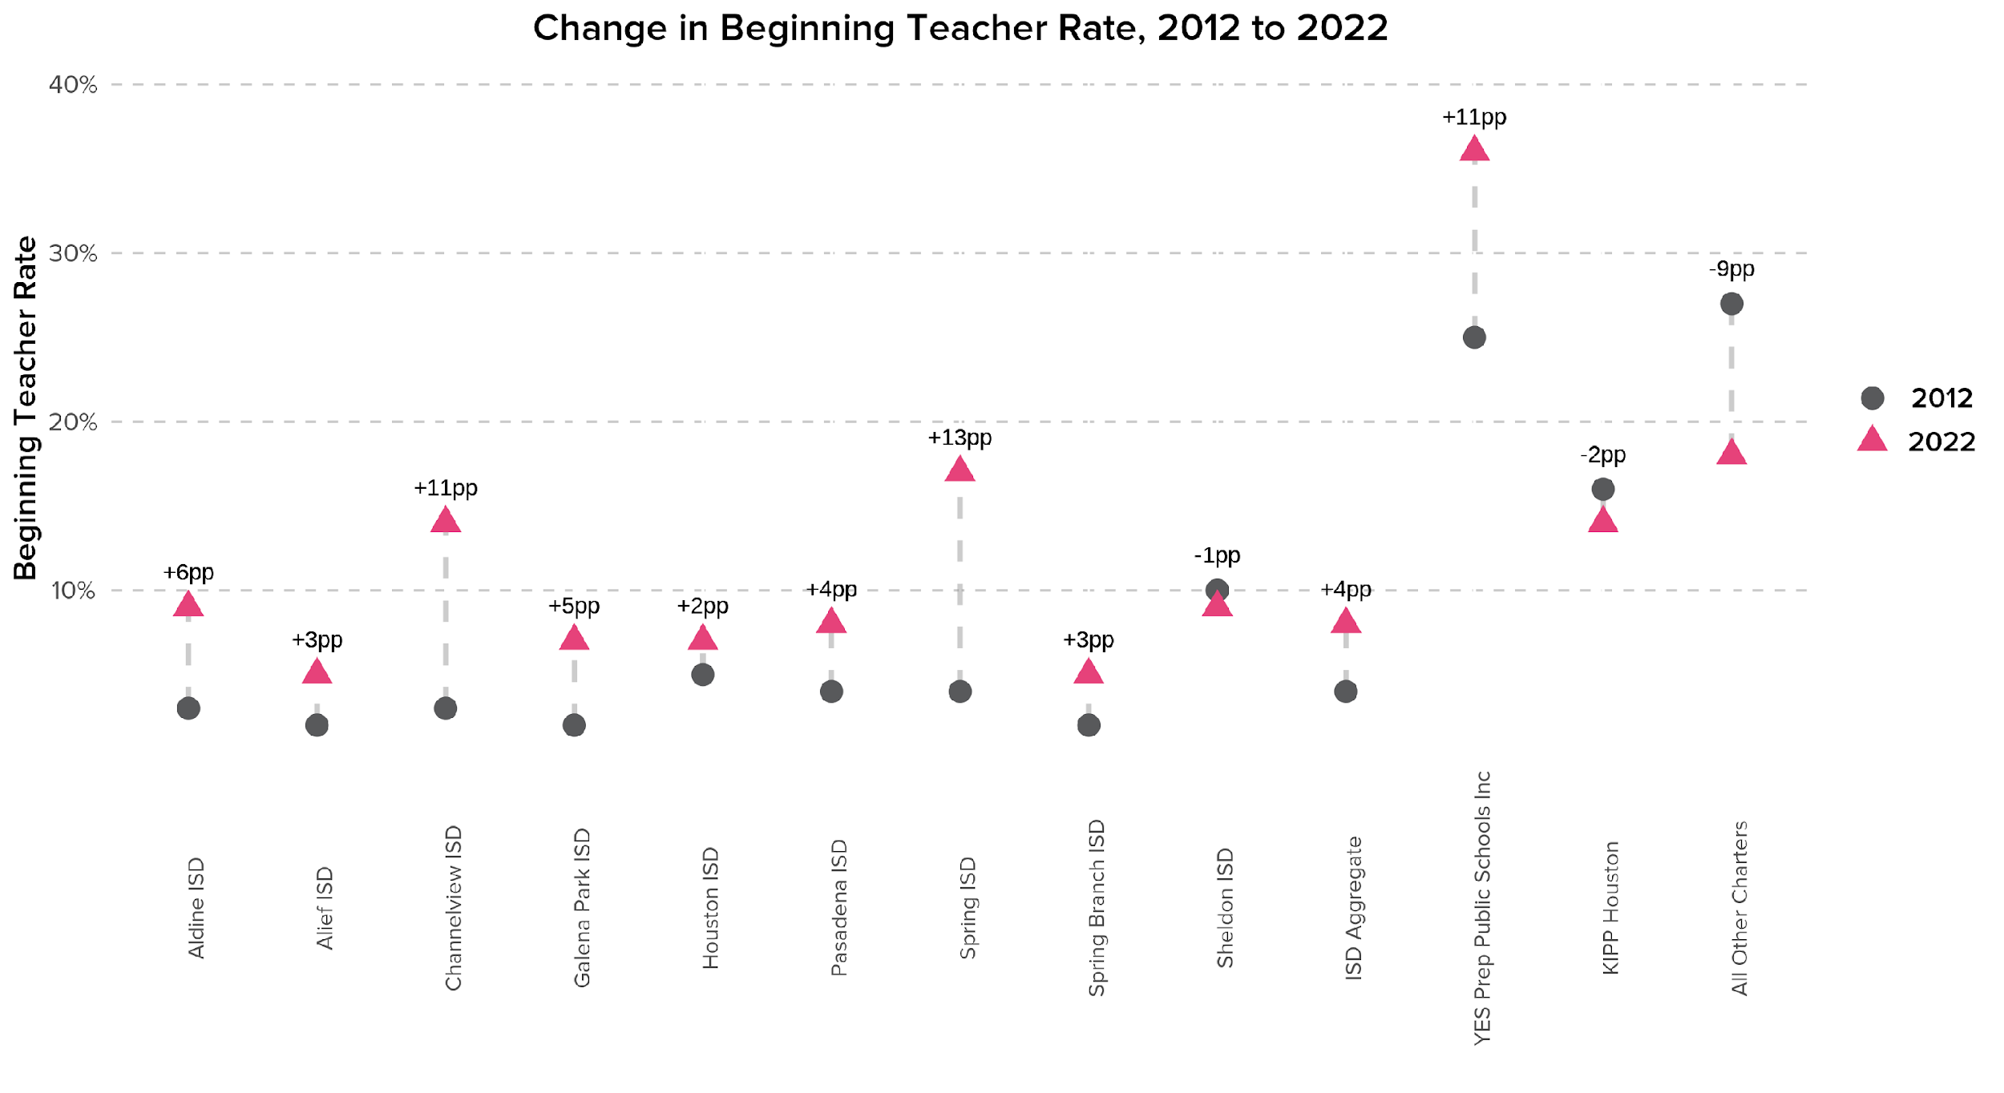
Channelview ISD, Spring ISD, and YES Prep all saw double digit increases in their beginning teacher rates since 2012.
Source: TEA TAPR, 2012 and 2022

Slide 22
Teacher Salaries

Slide 23
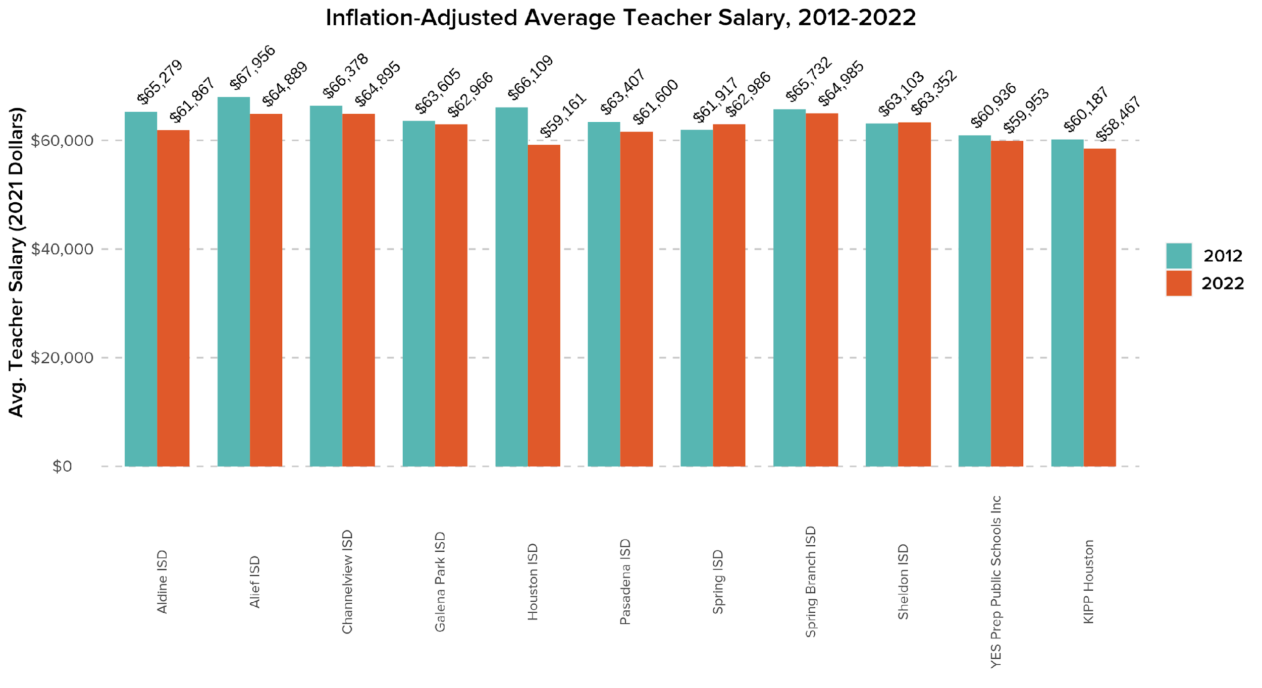
Most Houston-area ISDs and charters have seen notable decreases in inflation-adjusted salaries since 2012
Source: TEA TAPR, 2012 and 2022

Slide 24
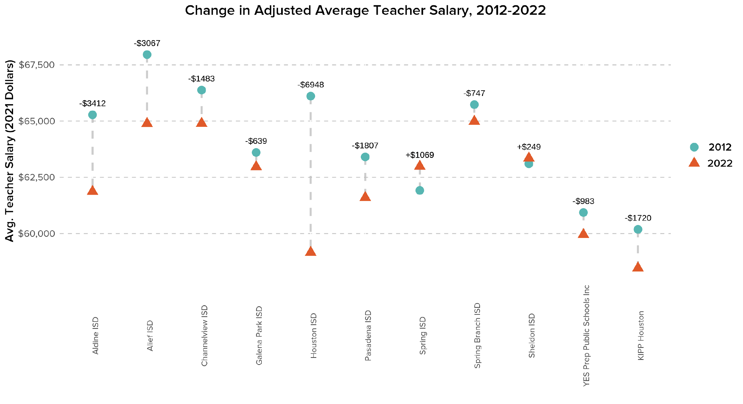
Adjusted for inflation, teachers in many Houston-area ISDs earned thousands of dollars less, on average, than in 2012.
Only Spring ISD teachers saw a meaningful increase in adjusted average salaries from 2012 to 2022.
Source: TEA TAPR, 2012 and 2022

Slide 25
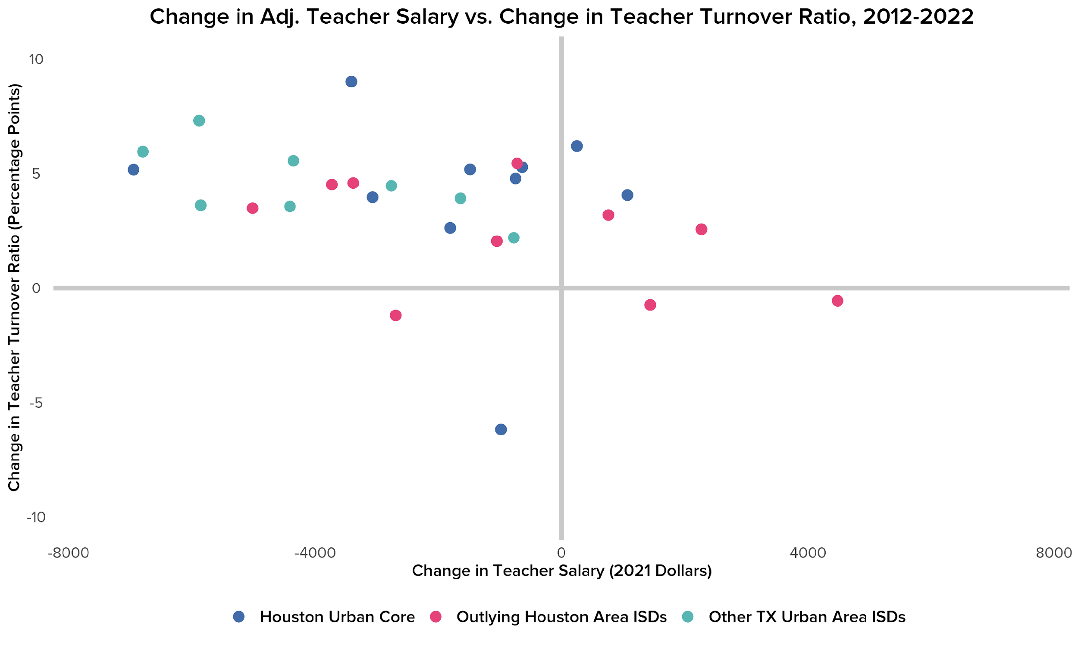
Most ISDs around Houston and Texas saw declines in real teacher salaries since 2012, while their teacher turnover ratios increased.
Source: TEA TAPR, 2012 and 2022

Slide 26
Only 4 districts saw decreases in teacher turnover ratio since 2012; 2 of those also saw decreased salaries after inflation.
Source: TEA TAPR, 2012 and 2022

Slide 27
Appendix 1: Other Figures

Slide 28
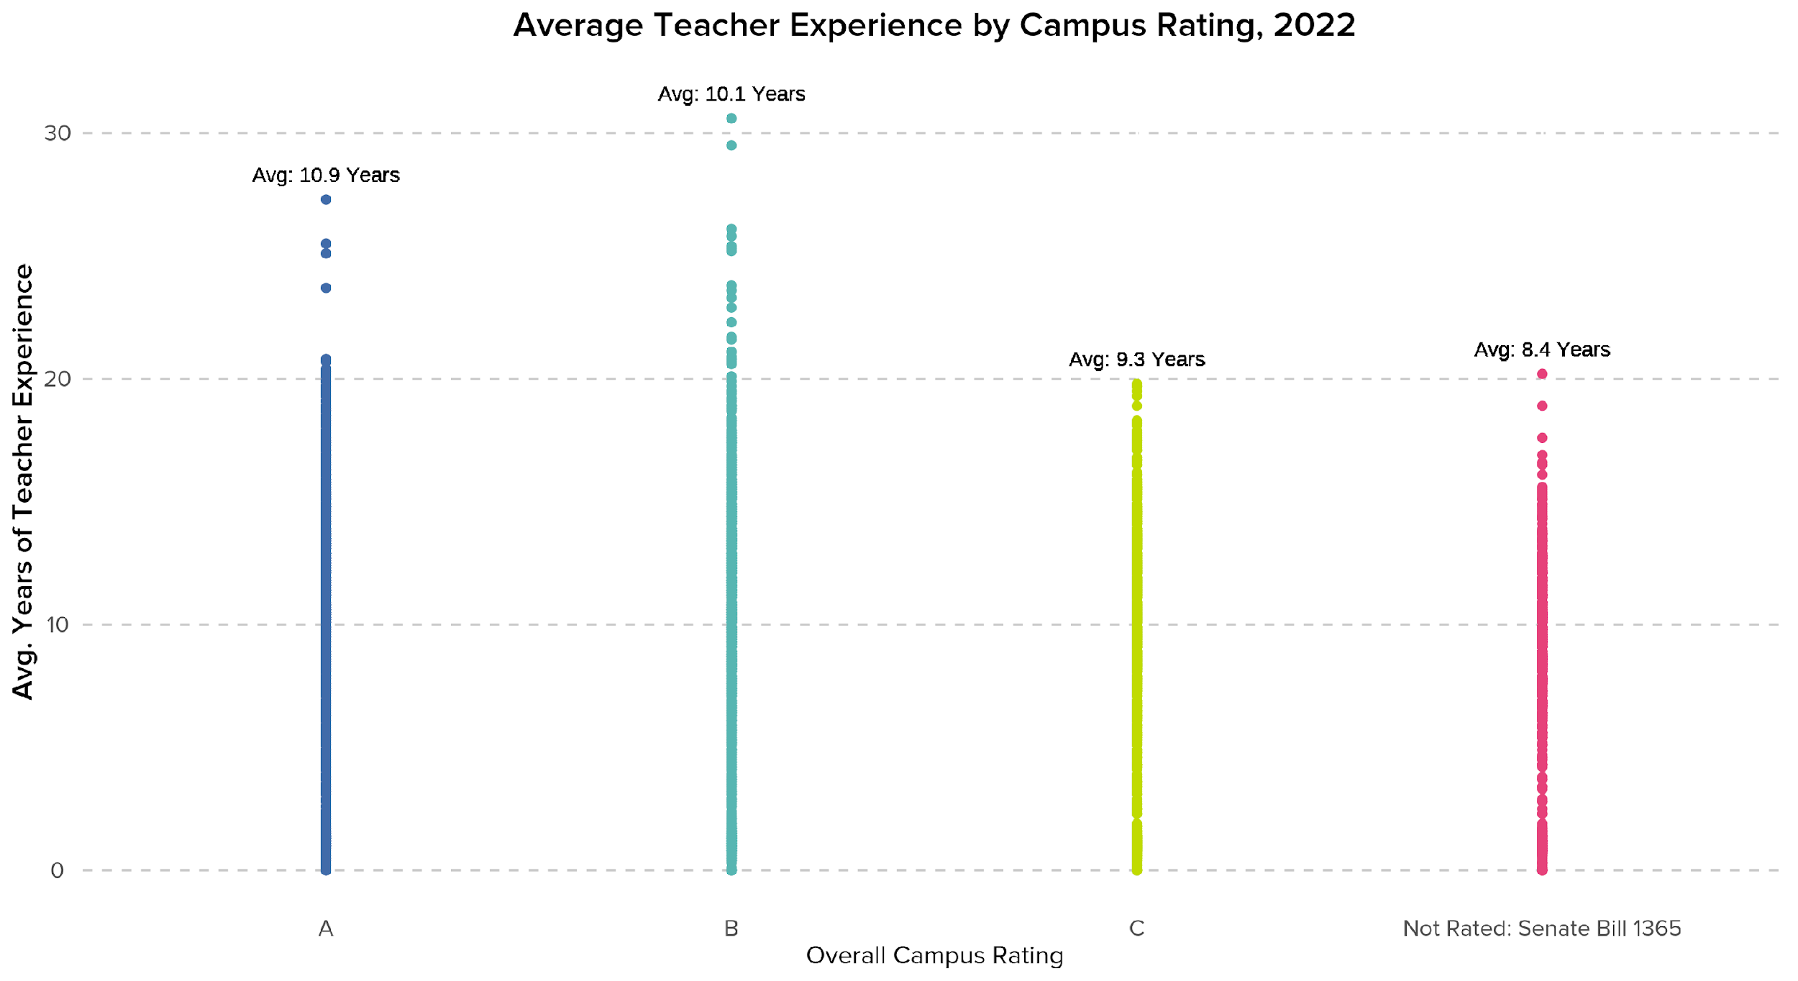
Average teacher experience is lower in campuses that were not rated in 2022 under SB 1365.
Source: TEA TAPR, 2012 and 2022; TEA Accountability Reports, 2022

Slide 29
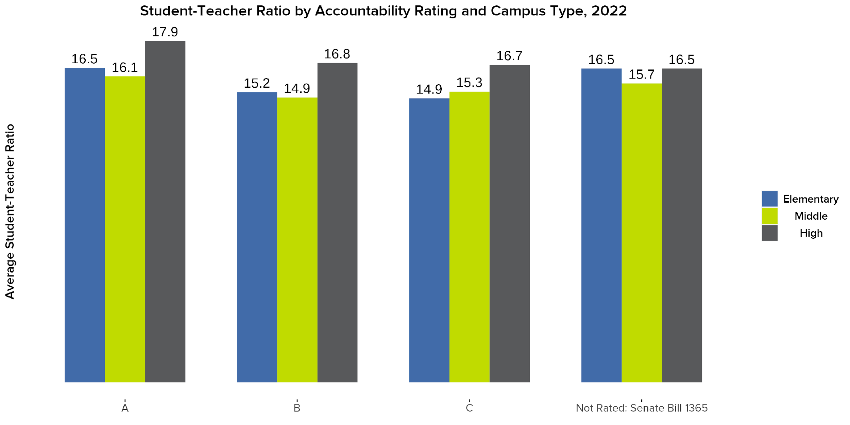
Student-teacher ratios vary across campus accountability ratings by grade type.
Source: TEA TAPR, 2012 and 2022; TEA Accountability Reports, 2022

Slide 30
Appendix 2: Prior Year Figures

Slide 31
From 2012, Teachers With 1-5 Years of Experience Remain the Largest Cohort of all Experience Bands Within Houston Districts
Percentage Of All Teachers By Band of Experience From 2012 to 2021

Slide 32
There is No Relationship Between Teacher Experience and 3rd Grade Reading Proficiency in the Houston-area
Teacher Experience vs. 3rd Grade Reading Proficiency in the Houston-area, 2021
3rd Grade Reading Proficiency
Teacher Experience (Years)
Source: TEA TAPR, 2021 and TEA STAAR, 2021

Slide 33
There is No Relationship Between Teacher Experience and 4th Grade Math Proficiency in the Houston-area
Teacher Experience vs. 4th Grade Math Proficiency in the Houston-area, 2021
4th Grade Math Proficiency
Teacher Experience (Years)
Source: TEA TAPR, 2021 and TEA STAAR, 2021

Slide 34
There is a Slight Positive Relationship Between Teacher Experience and 8th Grade Science Proficiency in the Houston-area
Teacher Experience vs. 8th Grade Science Proficiency in the Houston-area, 2021
8th Grade Science Proficiency
Teacher Experience (Years)
Source: TEA TAPR, 2021 and TEA STAAR, 2021

Slide 35
There is Little Relationship Between Teacher Experience and CCMR in the Houston-area
Teacher Experience vs. CCMR in the Houston-area, 2021
CCMR
Source: TEA TAPR, 2021
Teacher Experience (Years)

Slide 36
Appendix 3: Another View of Change

Slide 37
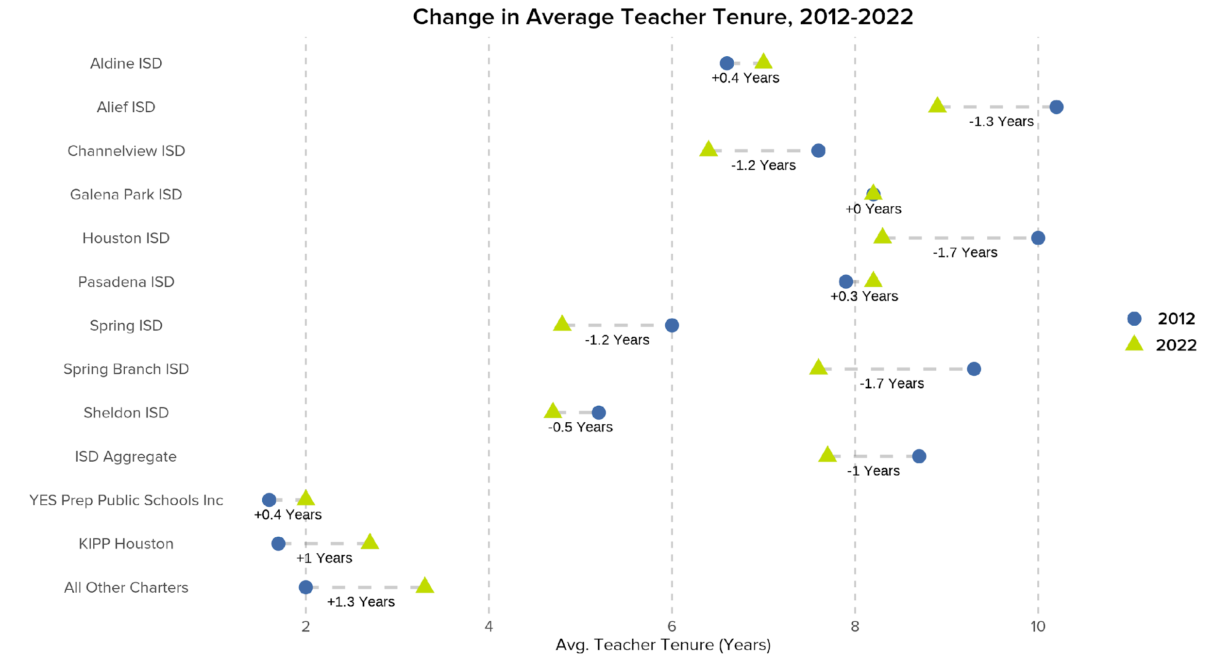
Most Houston-area ISDs saw decreases in average teacher tenure since 2012, showing teachers are staying with a district for less time.
Source: TEA TAPR, 2012 and 2022

Slide 38
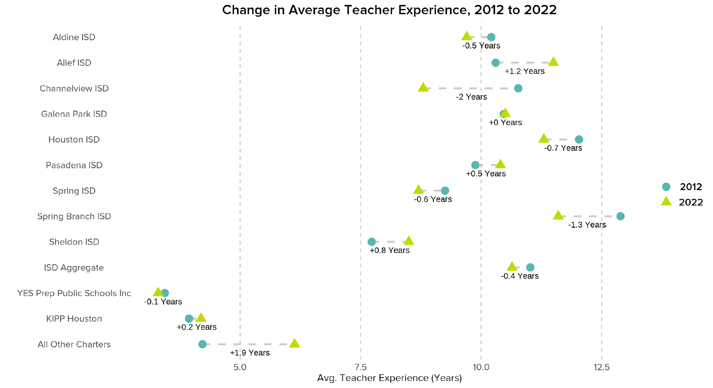
Similarly, average teacher experience has declined or stayed flat since 2012 at many—but not all—Houston-area ISDs.
Source: TEA TAPR, 2012 and 2022

Slide 39
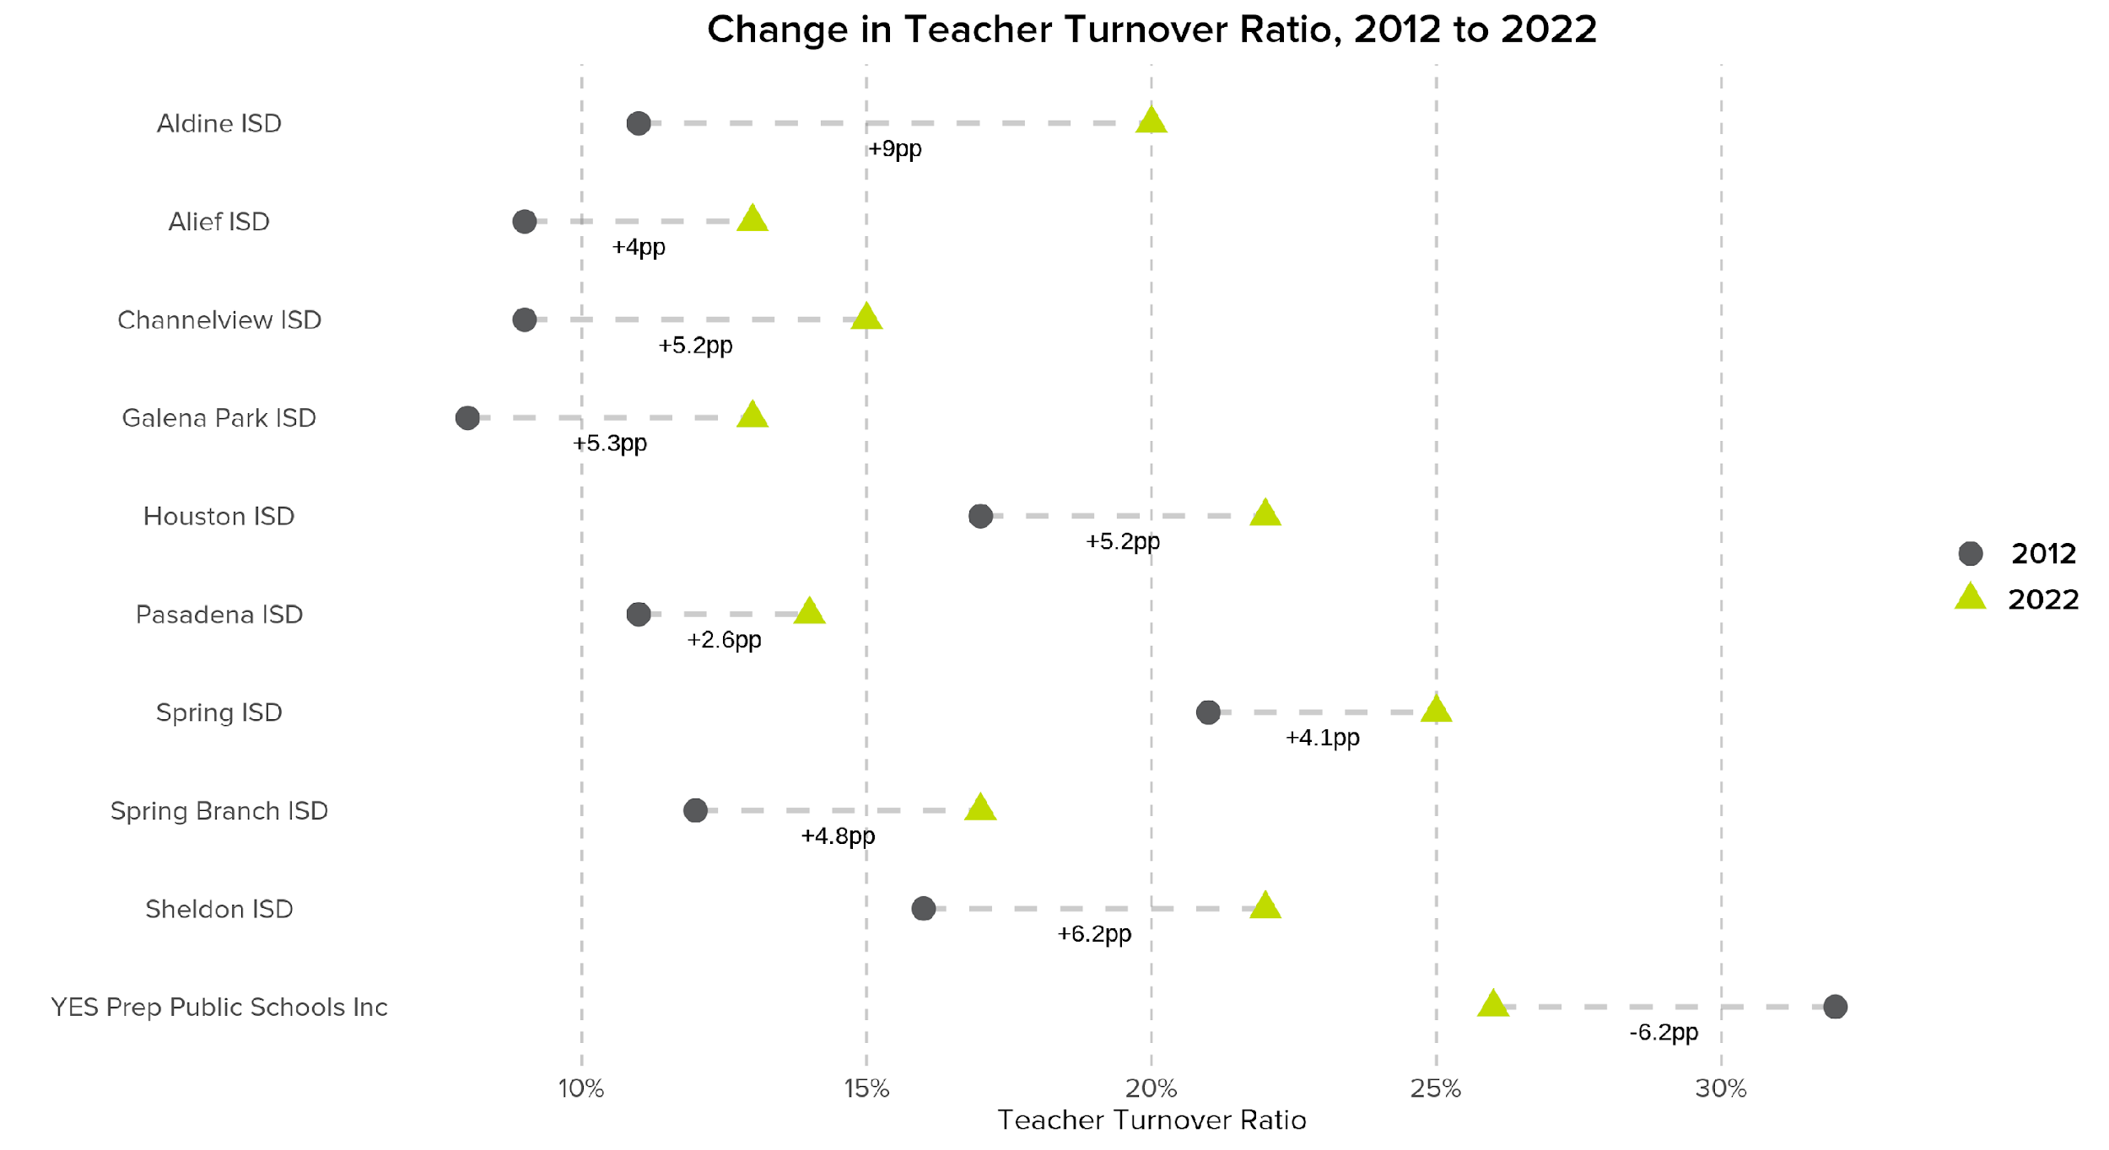
All Houston-area ISDs saw increases in their teacher turnover ratios since 2012, while YES Prep’s teacher turnover declined.
Source: TEA TAPR, 2012 and 2022

Slide 40
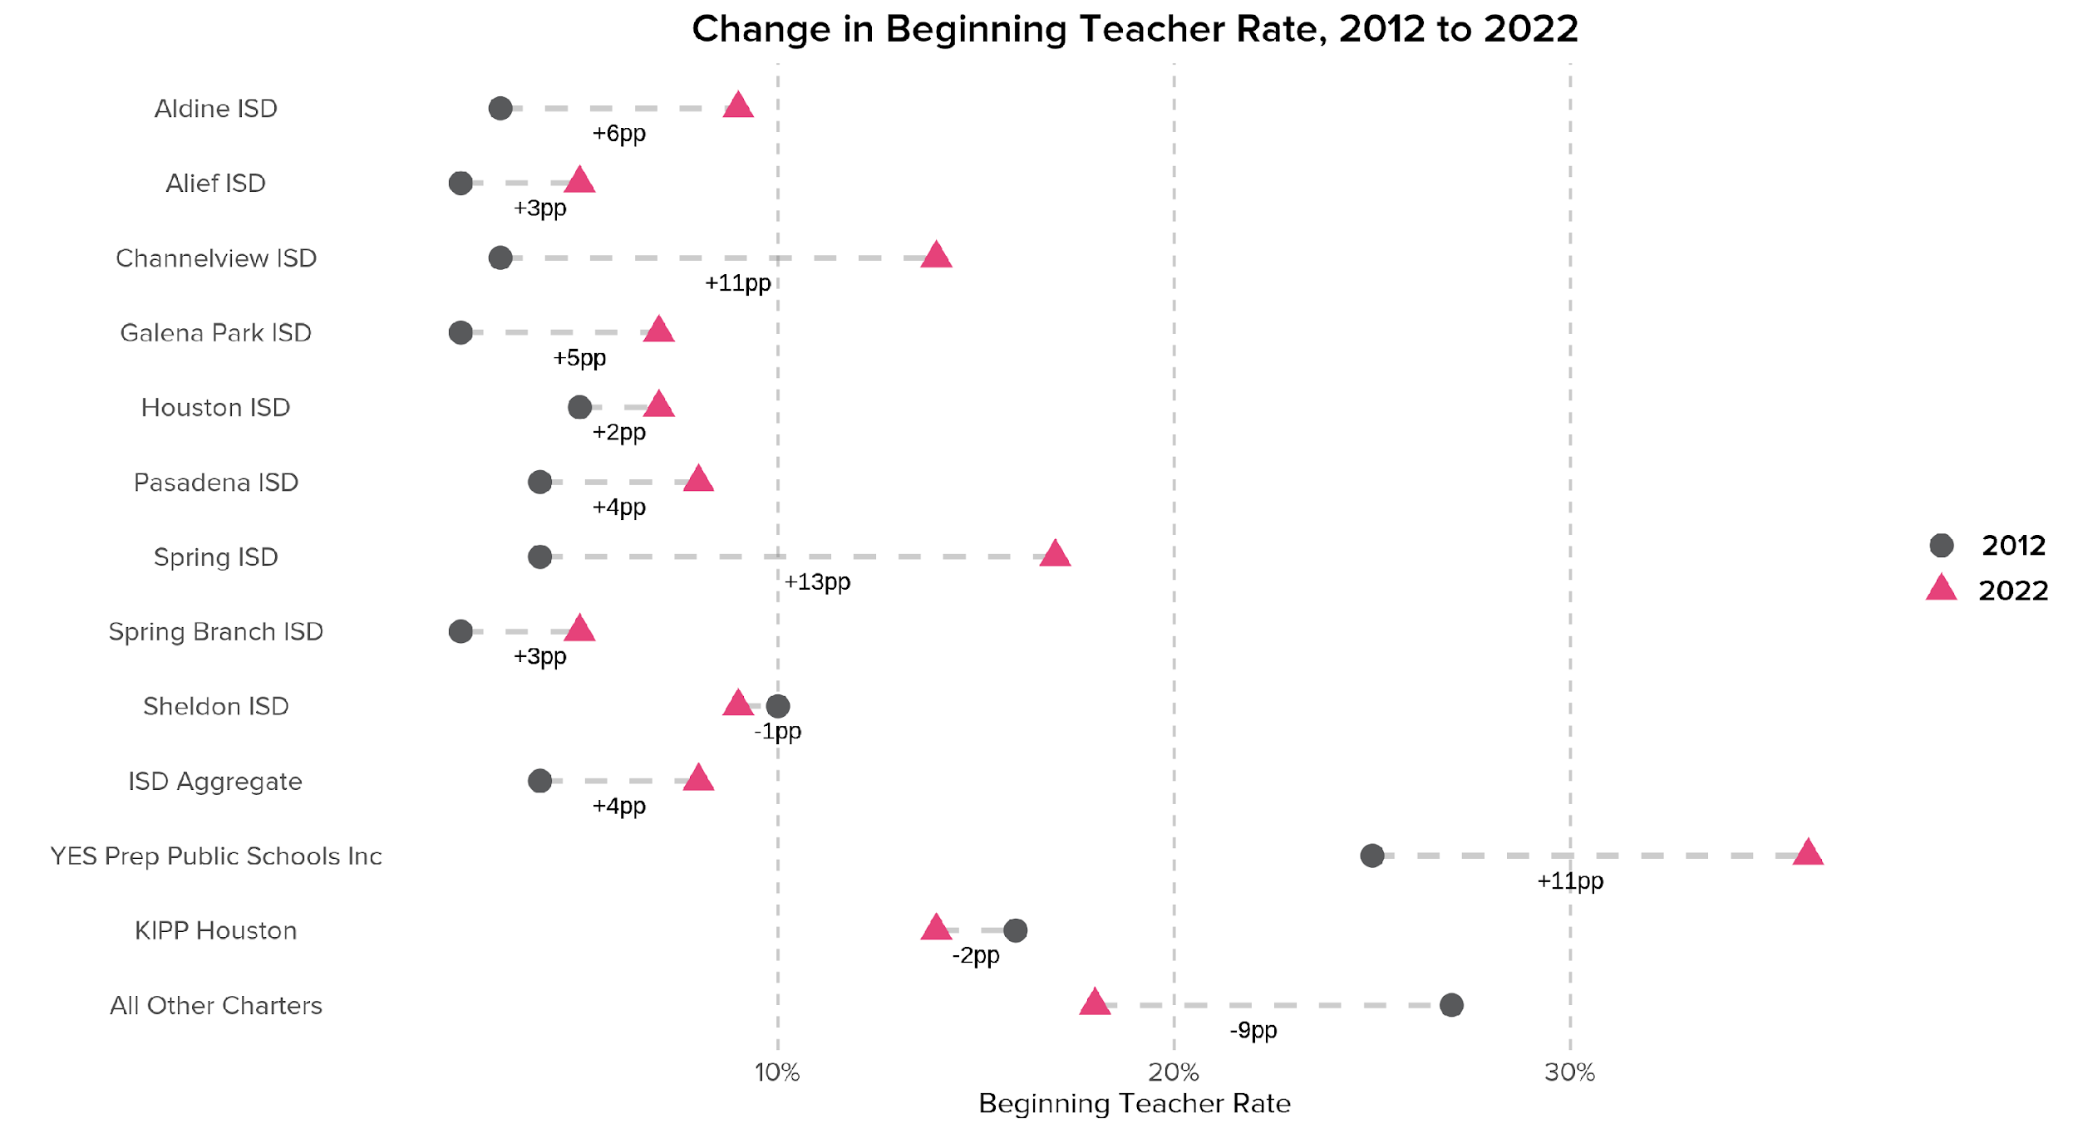
As teacher turnover ratios have increased, so has the proportion of beginning teachers at most Houston-area ISDs and charters.
Source: TEA TAPR, 2012 and 2022

Slide 41
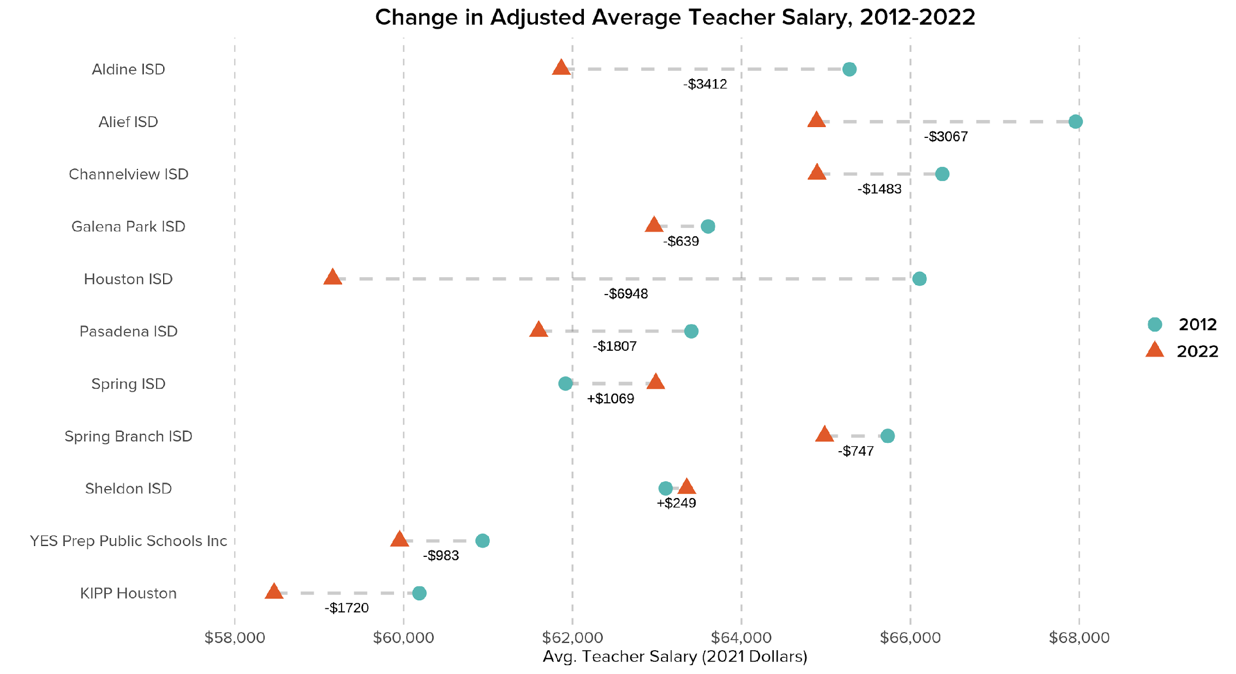
Most Houston-area ISDs and charters have seen notable decreases in inflation-adjusted salaries since 2012
Source: TEA TAPR, 2012 and 2022

